Slide 1



Slide 2
table of contents
01
02
03
Introduction
problems
SolutiONS
04
05
Working model
Revenue model
What “Labour Dekho” is all about
What problems are we trying to solve
How we are going to provide solutions to the problems
How our platfrom will work
How will we generate revenue

Slide 3
01
introduction
What “Labour Dekho” is all about

Slide 4

labour dekho
A employment-focused social platform
A platform where labours can find jobs easily
A platform where thekedars can hire labours in bulk
A platform where builders can contact thekedars directly
A platform which helps to connect labours,thekedars and builders on a social network
k here

Slide 5
02
Problems
What problems are we trying to solve

Slide 6



What problems are we solving
labours
thekedars
builders
Problems faced by thekedars
Problesm faced by labours
Problems faced by builders

Slide 7
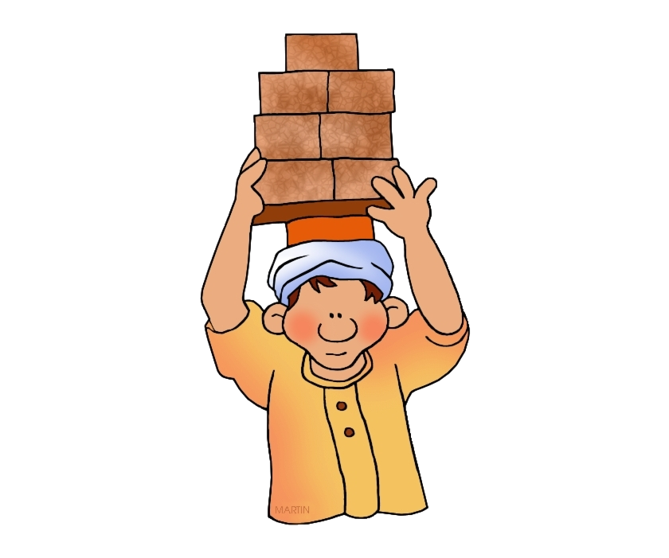
Problems faced by labour
Weak hiring network
Lack of job oportunity
Exploitation of wages
Lack of focus towards medical help and safety measures and other services

Slide 8
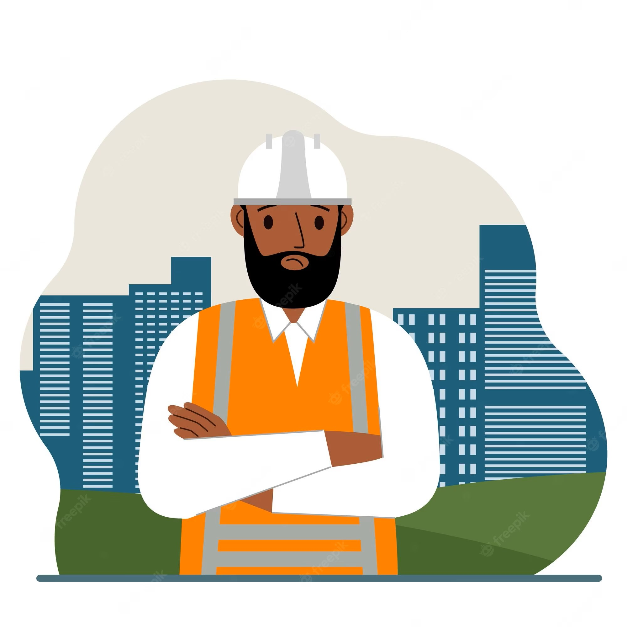
Problems faced by thekedars
Unable to hire labours In bulk in less time
Less number of labour force
Unable to find skilled labours for a paticular job

Slide 9
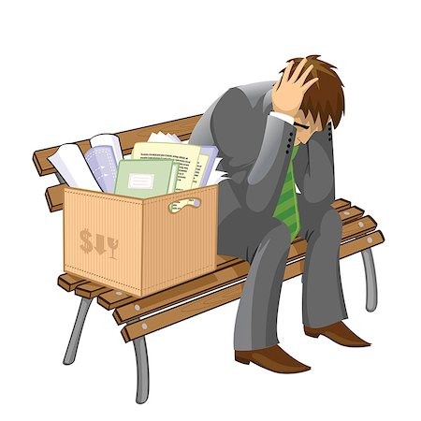
Problems faced by clients and builders
Unable to find reliable thekedars for big projects
Projects delayed due to skilled labour shortage
Poor regulations and management system

Slide 10
03
Solutions
How we are going to provide solutions to the problems

Slide 11
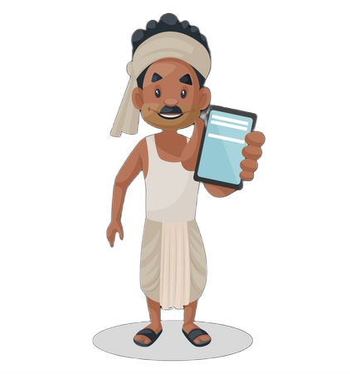
Solutions for labours
We are building a social network for labours to connnect with thekedars easily
Number of active labour force increase
We will set a proper wages system
We will provide medical insurances and safety gears

Slide 12
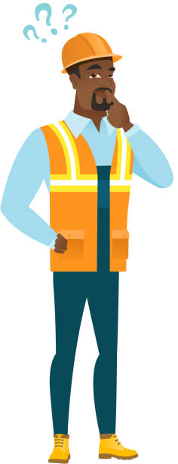
Solutions for thekedars
Thekedars can hire labours on bulk due to large number of labours present on our platform
Thekedars can find labours according to their need with the help of well defined labour profile

Slide 13
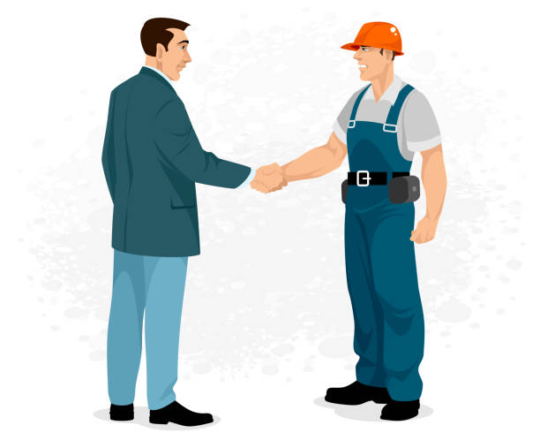
Solutions for builders and clients
Builders and clients can get reliable thekedars easily
Clients can directly hire labours for small projects
A proper management system to ensure no complaints from the client

Slide 14
working
04
model
How our platfrom will work

Slide 15
Working cycle
step 1
Step 2
Step 3
step 4
Client or Builder will post work application or hire a suitable thekedar
Thekedar will accept the application and will start hiring labours by posting a job application for labours
Labours will start filling the job application and contact the thekedar
After the complition of the project, the application will be closed and payements will be done from the app

Slide 16
revenue
05
model
How will we generate revenue

Slide 17
commission
Thekedars/contractors
Builders/clients
We will ask for commission on each labour/worker hired from the app
We will ask for commisson on hiring a thekedar/contractor from the app

Slide 18
MISSION STATEMENT
We want to create a digital platform to increase job opportunity for labours by bringing Thekedars/Contractors and Builders/clients on a single place

Slide 19
THANKS!
BCA 2ND YEAR
PRESENTED BY – ADITYA, ANURAG, ADITYA MIDDHA, ANKUR SINGH
Please keep this slide for attribution

